Slide 1
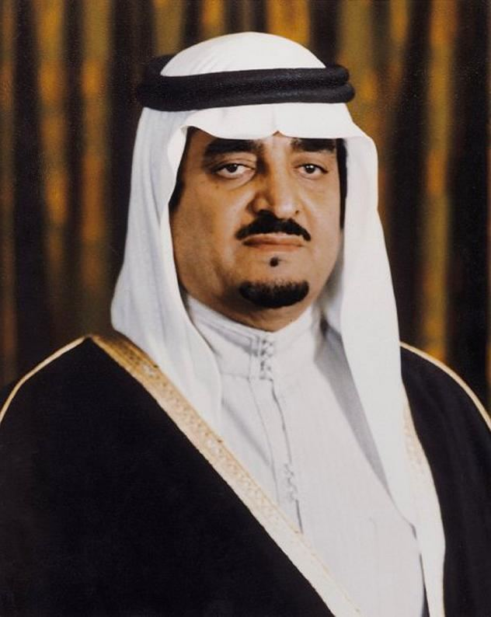

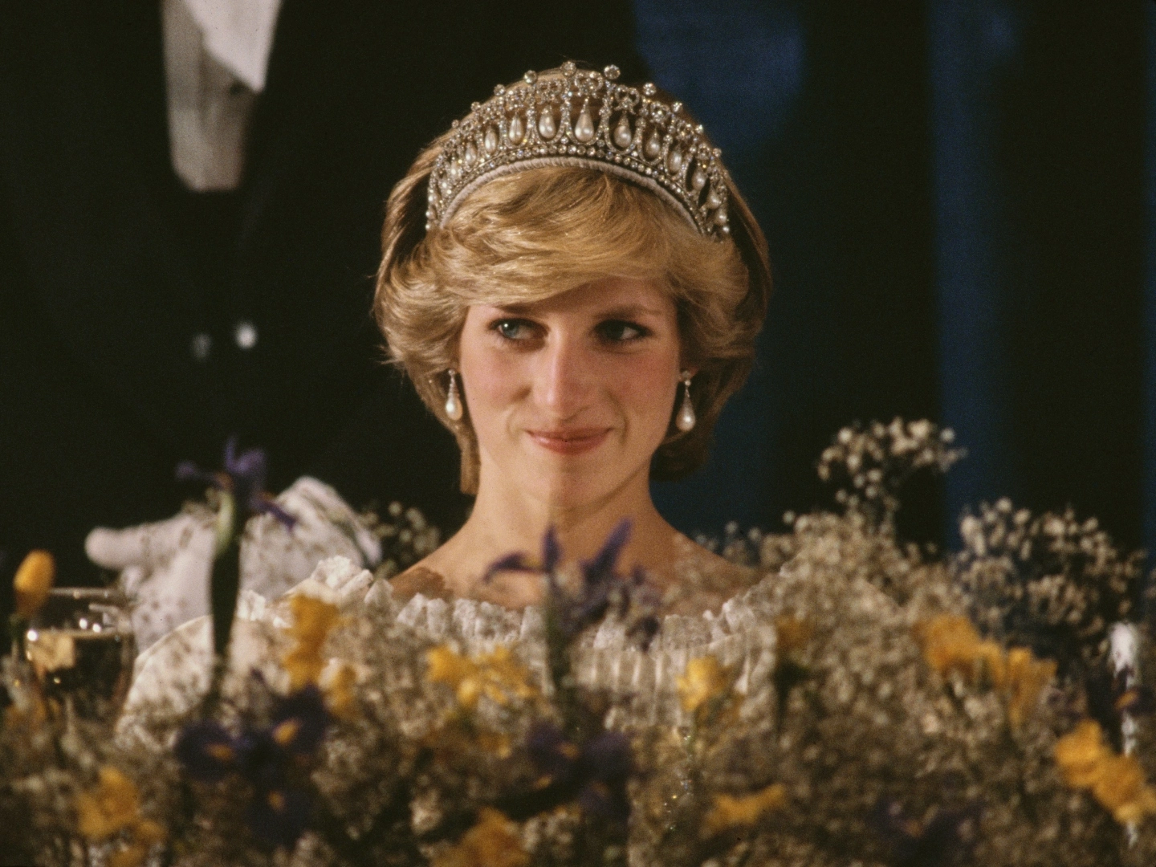

In 1997
I was born in 1997 .
Fahd bin Abdulaziz Al Saud was King of Saudi Arabia .
Official provision of the Internet in Saudi Arabia.
The Death of Princess Diana .
The Confederations Cup was held in Saudi Arabia.

